Slide 1




Operating System principle
2019-2020-2

Slide 2

Directory
Part 1 Introduction to operating systems
Part 2 Process description and control
Part 3 Processor scheduling and deadlock
Part 4 Memory management
Part 5 Virtual memory
Part 6 Input/output system
Part 7 File management
Part 8 Management of disk storage

Slide 3

Part1 Introduction to operating systems
1.1 Objectives and roles of the operating system
1.2 Operating system development process
1.3 Basic features of the operating system
1.4 The main functions of the operating system
1.5 OS structure design

Slide 4
1.1 Objectives and roles of the operating system
The objectives of the operating system are related to the application environment. For example, the OS used in the query system is expected to provide good man-machine interaction; For OS applied in industrial control, weapon control and multimedia environment, it is required to have real-time performance. For the OS configured on the microcomputer, the more important is its ease of use.

Slide 5
1.1.1 The Objectives of the operating system
1. Convenience
A computer system without OS configuration is extremely difficult to use.
2. Effectiveness
The first meaning of effectiveness is to improve the utilization of system resources; Another meaning is to increase the throughput of the system.

Slide 6
1.1.1 The Objectives of the operating system
3. Extensibility
In order to adapt to the requirements of computer hardware, architecture and the development of computer applications, OS must be very extensible.
4. Openness
Openness is the ability of a system to comply with world standards, especially the OSI international standards for open systems interconnection.

Slide 7
1.1.2 The role of the operating system
1. OS acts as an interface between the user and the computer hardware system
The meaning of OS as the interface between the user and the computer hardware system is: the OS is between the user and the computer hardware system, and the user USES the computer system through the OS. In other words, with the help of OS, users can easily, quickly and reliably manipulate computer hardware and run their own programs. Figure 1-1 is a schematic diagram of the OS as the interface.

Slide 8
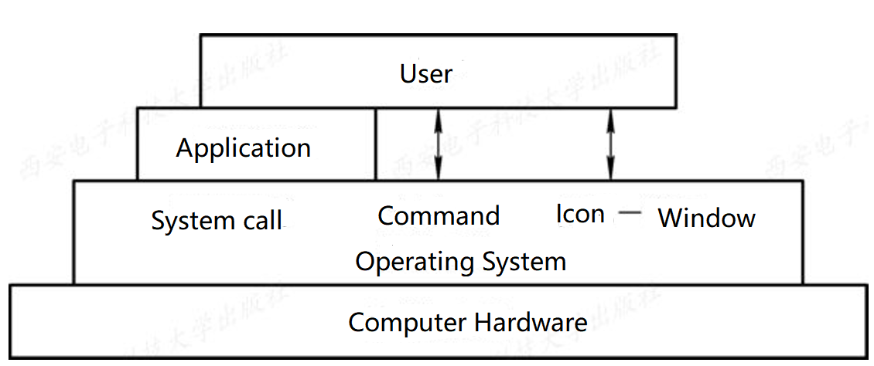
Figure 1-1 a schematic diagram of the OS as the interface

Slide 9
2. OS acts as the manager of the computer system resources
In a computer system, there are usually multiple hardware and software resources. These resources can be grouped into four categories: processor, memory, I/O devices, and files (data and programs). Accordingly, the main function of OS is to manage these four types of resources effectively. Processor management is used to allocate and control the processor. Memory management is mainly responsible for memory allocation and recovery; I/O equipment management is responsible for the distribution (recovery) and operation of I/O equipment; File management is used to achieve the access, sharing and protection of files. Thus, OS is indeed the manager of computer system resources.

Slide 10
3. OS implements the abstraction of computer resources
For a completely software-free computer system (that is, bare-metal), because it provides only a hardware interface (physical interface) to the user, the user must have a full understanding of the implementation details of the physical interface, which makes the physical machine difficult to use widely. In order to facilitate users to use the I/O devices, people on the bare machine covered with a layer of I/O device management software, as shown in figure 1-2, by it to realize to the I/O device operation details, and to the general I/O device abstraction for a set of data structure and a set of I/O operations command, such as read and write command, so that users can use the data structure and the operation command for data input or output, without having to care about is how to realize the I/O.

Slide 11
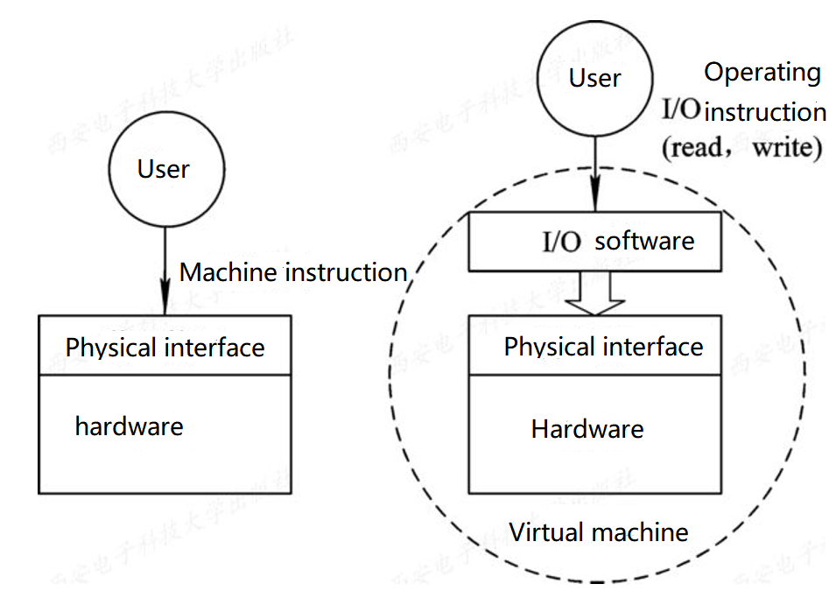
Figure1-2 I/O software hides the details of the implementation of I/O operations

Slide 12
1.1.3 Driving the development of operating systems
1．Constantly improve the utilization rate of computer resources
In the early days of computer development, computer systems were extremely expensive. People had to do everything possible to improve the utilization of various resources in computer systems. This was the driving force behind the initial development of OS.
2. Convenience for users
When the problem of low resource utilization rate is basically solved, the user's inconvenience in debugging the program becomes the main contradiction. This, in turn, is the main factor that continues to drive OS development.

Slide 13
1.1.3 Driving the development of operating systems
3. Constant replacement of devices
4. Continuous development of computer architecture
The development of computer architecture is also driving the development of OS and the generation of new OS types.
5. Constantly put forward new application requirements
Another important reason for the rapid growth of operating systems is that people are constantly demanding new applications.(Real-time operating system,miniaturization)

Slide 14
1.2 Operating system development process
In the mid-1950s, the first simple batch OS appeared; The mid-1960s saw the development of a multiprogramming batch system; Time-sharing systems were soon introduced, along with real-time OS for industrial and weapons control. From the 1970s to the 1990s, VLSI and computer architecture of the era of great development, leading to the birth and development of the microcomputer, multi-processor and computer network, and correspondingly, the development of microcomputer OS, multi-processor OS and network OS, and get very rapid development.

Slide 15
1.2.1 A computer system with no operating system configured
1. Manual mode
In the early days, programmers loaded punched paper tape (or CARDS) into paper tape inputers (or card inputers), started them, fed programs and data from the tape into the computer, and then started the computer. The next user is allowed to go on the computer only after the program has run and the results have been removed. This manual operation mode has the following two disadvantages :(1) the user monopolizes the whole machine, that is, all the resources of a computer are monopolized by the user on the machine. (2) CPU waits for manual operation. When the user performs manual operations such as loading (card) and unloading (card), resources such as CPU and memory are idle.

Slide 16
2. Off-Line I/O
Offline I/O technology was introduced in the late 1950s to address human-machine conflicts and speed mismatches between CPU and I/O devices. In this technology, the paper tape containing the user's program and data is loaded into the paper tape input machine and the data on the paper tape (card) is input into the tape under the control of a peripheral machine. When the CPU needs these programs and data, it calls them into memory at high speed from the tape.

Slide 17
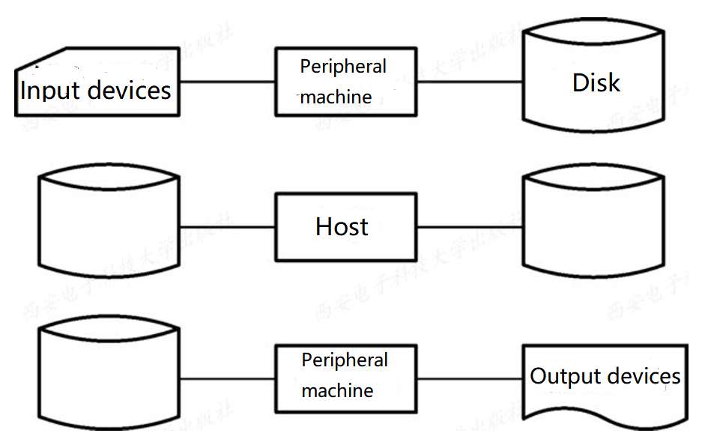
Figure1-3 Schematic of offline I/O

Slide 18
1.2.2 Simple Batch Processing System
1. The process of a Simple Batch Processing System
Single channel to achieve continuous processing of jobs, a batch of jobs need to be first input to tape in an offline mode, and the system is equipped with a Monitor, under its control, the batch of jobs can be continuously processed one by one.

Slide 19
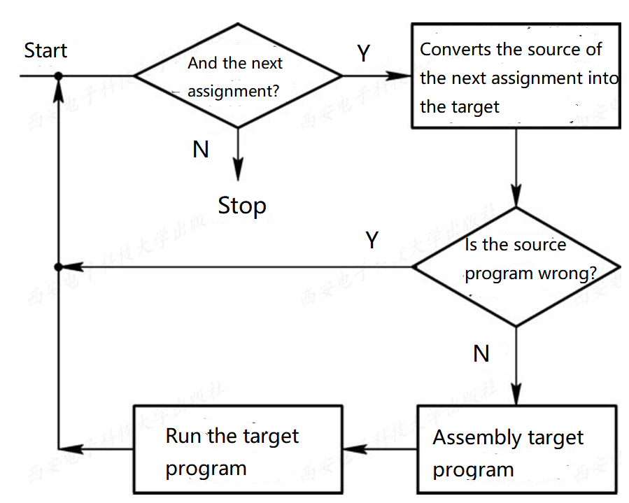
Figure1-4 The process flow of a single batch system

Slide 20
2. Disadvantages of a Simple Batch Processing System
The major disadvantage of a single batch system is that the resources in the system are not fully utilized. This is because there is only one program in memory, and every time the program makes an I/O request while it is running, the CPU waits and must wait until its I/O completes. Due to the low speed of I/O devices, the CPU utilization is significantly reduced. Figure 1-5 shows the operation of a single program. It can be seen from the figure that the CPU is idle in the time interval of t2 ~ t3 and t6 ~ t7.

Slide 21
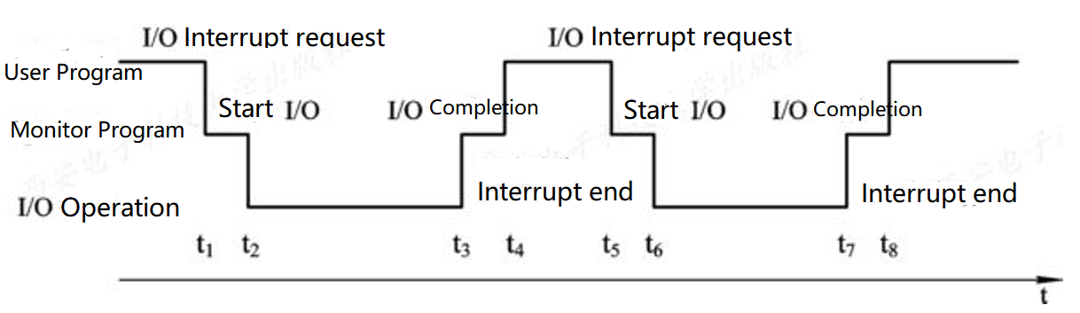
图1-5 The operation of a single program

Slide 22
1.2.3 Multiprogrammed Batch Processing System
1. The basic concept of multiprogramming
In order to further improve the utilization of resources and system throughput, multi-programming technology was introduced in the mid-1960s, which resulted in multi-channel batch processing system. Figure 1-6 shows the operation of four programs.

Slide 23
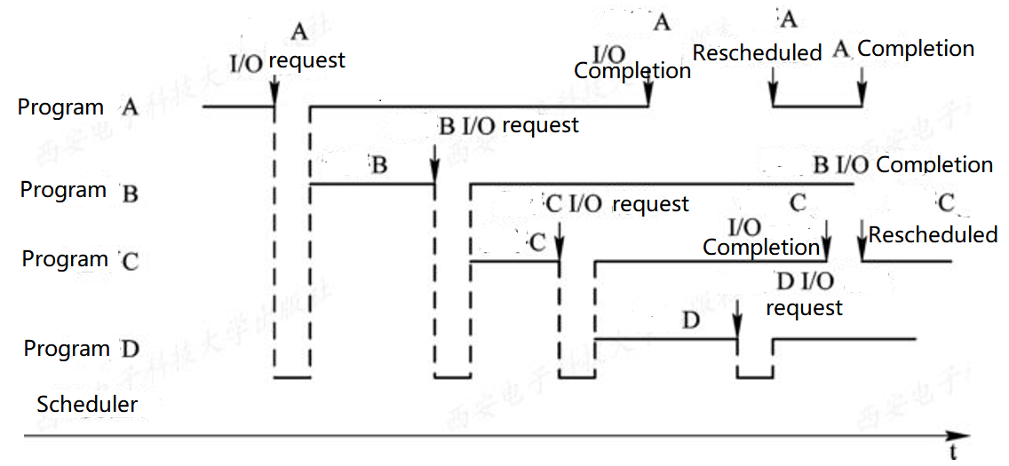
Figure1-6 The running condition of Multiprogrammed program

Slide 24
2. Advantages and disadvantages of multi-channel batch systems
The advantages and disadvantages of multi-channel batch systems are as follows :(1) high resource utilization. The introduction of multi-channel batch processing can make multi-channel programs run alternately to keep the CPU busy. Loading multichannel programs in memory can improve the memory utilization. You can also increase the utilization of I/O devices. (2) high system throughput. The main reasons for increased system throughput can be summarized as: (1) CPU and other resources to keep "busy" state; (2) only when the job is completed or run down when the switch, the system overhead is small.

Slide 25
(3) long average turnaround time. Because jobs are queued up for processing, the turnaround time is long, often taking hours or even days. (4) no interaction ability. Once the user submits the job to the system, the user cannot interact with his job until the job is completed. It is very inconvenient to modify and debug the program.

Slide 26
3. A problem that needs to be solved in a multi-channel batch system
Multi-channel batch system is a very efficient but very complex system. In order for the multi-channel programs in the system to work in harmony, the system must solve the following problems :(1) processor contention problem. Not only to meet the needs of each program, but also to improve the utilization of the processor. (2) memory allocation and protection. The system should be able to allocate the necessary memory space for each program, so that they are "in their place" and do not destroy other programs because of abnormal conditions in one program. (3) I/O equipment allocation. The system should adopt appropriate strategies to allocate I/O equipment in the system, so as to achieve the purpose of facilitating the use of equipment by users and improving the utilization rate of equipment.

Slide 27
(4) organization and management of documents. The system should be able to effectively organize the large number of procedures and data stored in the system, making them easy for users to use and ensuring the security of the data.
(5) job management. There are various jobs (applications) in the system, and the system should be able to reasonably organize all the jobs in the system to meet the different requirements of the users of these jobs.
(6) interface between the user and the system. To facilitate the use of the operating system, the OS should also provide an interface between the user and the OS.

Slide 28
1.2.4 Time Sharing System
1. The introduction of time-sharing system
If the main driving force for the formation and development of multi-channel batch processing system is to improve the resource utilization and system throughput, then the main driving force for the formation and development of time-sharing system is to meet the needs of users for man-machine interaction, thus forming a new OS. The requirements of users are embodied in the following aspects :
(1) man-machine interaction.
(2) Shared host.

Slide 29
2. The key problems in the realization of time-sharing system
In a multi-channel batch system, the main reason why users cannot interact with their jobs is that the jobs reside on external memory first, and even if they are called into memory later, they will wait for a long time before they can run, so users cannot interact with their jobs. 1) timely receipt 2) timely processing

Slide 30
3. The characteristics of time-sharing systems
Compared with multi-channel batch processing system, time-sharing system has distinct characteristics, which can be summarized into the following four aspects :
(1) multiplexing.
(2) independence.
(3) timeliness.
(4) interactivity.

Slide 31
1.2.5 Real Time System
1. Type of real-time system
With the popularity of computer applications, the number of types of real-time systems has increased correspondingly. The following is a list of the current common types :
(1) industrial (weapons) control systems.
(2) information inquiry system.
(3) multimedia system.
(4) embedded system.

Slide 32
2. Type of real-time task
(1) periodic real-time task and aperiodic real-time task.
(2) hard real-time task and soft real-time task

Slide 33
1.2.6 Development of microcomputer operating system
1．Single-user single-task operating system
1) CP/M
2) MS-DOS

Slide 34
2. Single-user multitasking operating system
Single-user multi-task operating system means that only one user is allowed to go on the computer, but it allows the user to divide the program into several tasks and make them execute concurrently, thus effectively improving the performance of the system.

Slide 35
3. Multi-user multi-task operating system
The meaning of multi-user multi-task operating system is that it allows multiple users to share various resources in the host system by using the same machine through their respective terminals, and each user program can be further divided into several tasks, so that they can be executed concurrently, so as to further improve the resource utilization and system throughput. In large, medium and small computer configuration is mostly multi-user multi-task operating system, and in 32-bit microcomputer, there are many configuration is multi-user multi-task operating system, the most representative is UNIX OS.

Slide 36
1.3 Basic features of the operating system
The three basic operating systems mentioned above have their own characteristics, such as high resource utilization and system throughput. Time-sharing system can get timely response; Real - time system has real - time characteristics. In addition, they share four basic characteristics: concurrency, sharing, virtual, and asynchronism.

Slide 37
1.3.1 Concurrence
It is the concurrent execution of programs in the system that enables the OS to effectively improve the utilization of resources in the system and increase the throughput of the system.
1. Parallelism and Concurrence
Parallelism and concurrency are two concepts that are both similar and distinct. Parallelism is the occurrence of two or more events at the same time. Concurrency is when two or more events occur at the same time interval.

Slide 38
2. The introduction of the process
In a system with no process introduced, there can only be sequential execution between the computation program belonging to the same application program and the I/O program. Conversely, when the program performs an I/O operation, the calculator cannot execute. But after a separate Process is created for the calculator and the I/O program, the two processes can execute concurrently. If you set up a process for multiple programs in memory, they can execute concurrently, which can greatly improve the utilization of system resources and increase the throughput of the system.

Slide 39
1.3.2 Sharing
Sharing in general does not have the same meaning as sharing in an operating system environment.
1. Mutually exclusive sharing
Certain resources in the system, such as printers, tape drives, etc., can be provided to multiple processes (threads), but it should be specified that only one process is allowed to access that resource for a period of time. To this end, a mechanism should be established in the system to ensure exclusive access to such resources by multiple processes.

Slide 40
2. Simultaneous access
There is another class of resources in the system that can be accessed "simultaneously" by multiple processes over a period of time. What is referred to here as "simultaneous" is in the macro sense in a single-processor environment, while at the micro level, these processes alternate access to the resource. A typical resource that can be accessed "simultaneously" by multiple processes is a disk device. Some files written in reentrant code can also be Shared "simultaneously," allowing several users to access the file simultaneously.

Slide 41
1.3.3 Virtual
1. Time division multiplexing
(1) virtual processor technology.
(2) virtual equipment technology.

Slide 42
2. Air division multiplexing
In the early 20th century, frequency division multiplexing (FDM) was used to improve the utilization of channels. It refers to the division of a channel with a wide frequency range into several channels with a narrow frequency range (called frequency band), of which any frequency band is only for one pair of users to talk. Early frequency-division multiplexing divided a physical channel into only a few to a few dozen lines, and soon grew to thousands of lines, each for a pair of users. Then in the computer also USES the air division multiplexing technology to the storage space management, in order to improve the storage space utilization.

Slide 43
1.3.4 Asynchronism
In a multiprogramming environment, the system allows multiple processes to execute concurrently. In a single-processor environment, because there is only one processor in the system, only one process is allowed to execute at a time, and the rest of the process has to wait. A request for a resource when executing process, such as print request, while the printers are for other processes, because printers are the critical resources, so must wait for executing process, and release the processor, idle until the printer, and again for processing machine, the process will continue. It can be seen that due to resource constraints and other factors, the execution of processes is often not "one go", but "stop-and-go" mode.

